Slide 1
A Novel Multi-Hop Routing Protocol for D2D Communications in 5G
AHMED, Rana E.
Carleton University, Canada
In: 2021 IEEE 11th Annual Computing and Communication Workshop and Conference (CCWC). IEEE, 2021. p. 0627-0630.

Slide 2
Outline
Abstract
Section 1: Introduction
Section 2: Multi-hop routing D2D
Section 3: The proposed protocal
Section 4: Conclusion
Notes:
1.
2.介紹提出此新型協定的動機，介紹經典的Dynamic Source Roting協定
3.介紹本文提出之協定multi-hop routing protocal不同於傳統DSR的特徵
4.模擬結果證實提出的協定規則能有更好的路由選擇及較低的能源消耗

Slide 3
Abstract
Device-to-Device (D2D) communication in 5G Networks provide faster and energy-efficient access to the devices within a cell.
In this paper, a new multi-hop routing protocol for D2D communications in 5G network is proposed.
Simulation results show that the proposed protocol achieves better results in terms of D2D routing success probability.
Notes:
5G 網路中的D2D通訊提供對小區域內設備的更快、更節能。
DSR協定常⽤於MANET，本⽂修改傳統的DSR協定，利⽤5G基礎建設來做出更快的路由決定，也能降低路由成本，達到讓節點更節能的目的。

Slide 4
Introduction
D2D communication has request: higher power efficiency, spectrum efficiency, and lower delays.
D2D communication in the caching strategies of contents sharing reduces traffic tremendously on the core network and backhaul links.
Routing in D2D communicating devices presents some challenges: mobility, non-cooperativeness, disconnection, interference, and battery constraints of mobile devices.
Notes:
D2D通訊需要⾼節能、⾼頻譜效率、低延遲等要求
D2D的快取策略可滿⾜邊緣網路的使⽤，因此許多UE會使⽤D2D，以減少核⼼網路的交通和回傳連結
D2D routing 的挑戰：移動性、非協作性、未連線、⼲擾、⾏動裝置的電池限制

Slide 5
Introduction
Multi-hop D2D communication challenges: route finding and route maintenance.
Most of the protocols reported are complex to implement in real practical networks.
The proposed protocol adds low overhead, and it performs better than the classical DSR by achieving better routing packet delivery ratio, better network management and overall network throughput.
Notes:
Source UE要連接非臨近的destination UE，多hop的協定是必須的
但是多hop的協定會有以下兩種常見的挑戰，包括路由尋找和路由維持
現有的協定在真實網路中過於複雜⽽難以實⾏
所提出的協議增加了低開銷，並且通過實現更好的路由數據包傳遞率、更好的網絡管理和整體網絡吞吐量，它比經典的 DSR 表現更好。

Slide 6
Multi-hop routing D2D
Motivation
A multi-hop routing protocol has challenges:
1. Minimal or no participation of BS in the route discovery process.
2. Use of BS in maintaining an up-to-date record about D2D sessions within a cell.
3. A simple, low-overhead, strategy for route discovery and route maintenance.
4. Minimizes the broadcast storm of RREQ packets in the network.
Notes:
基地台很少或沒有參與路由發現過程。
使用基地台會維護有關小區內D2D會話的最新記錄，以及D2D會話內的路由信息​​。
一種簡單、低開銷的路由發現和路由維護策略，通過修改傳統的動態源路由以適應 5G 中的 D2D 通信。
網路中RREQ 數據包的廣播風暴。

Slide 7
Conventional Dynamic Source Roting
DSR is a reactive (or “on-demand”) protocol, and it does not require continuous information updates.
Sourse node broadcasts the Route Request (RREQ) packets to its immediate neighbors.
The destination node, after receiving the first RREQ packet, replies to the source node using the Route Reply (RREP) packet through the reverse path the RREQ packet had traversed.
Notes:
DSR是⼀種反應型的協定，不需要資訊不斷更新，⽽是藉由廣播RREQ封包給鄰近節點
在路由發現階段，當S節點沒有到D節點的路由信息​​，而有數據包要發送到D節點時，就向它的直接鄰居廣播路由請求RREQ包。每個中間節點在收到 RREQ 後，如果尚未轉發數據包或該節點不是目標節點，則將封包重新廣播給其鄰居。
⽬標節點收到RREQ會回覆RREP封包，中間節點可以利⽤快取來存取鄰近的路由選擇，未來選擇路由的資訊、路由最佳化

Slide 8
Conventional Dynamic Source Roting
In case of broken link, the immediate a ffected nodes send Route Error (RRER) control packet along the route and all intermediate nodes update their caches.
A node has an up-to-date information which is periodically updated by sending “Hello”-type packets.
If unsuccessful to get routing information from its immediate neighbors, then X sends the request to the BS.
Notes:
在連線斷開的的情況下，直接受影響的節點沿路由發送路由錯誤控制包RRER，所有中間節點更新它們的暫存在路由訊息中反映斷連的狀態。
新協定會讓節點週期性更新路由資訊
來源節點會傳送探查訊息給鄰近節點，若從鄰近節點得不到想要的資訊，就會從基地台要求資訊，或是進入發現路由的過程

Slide 9
Conventional Dynamic Source Roting
A “non-active” node cannot be an intermediate relaying node.
On receiving an RREQ packet, an “active” node X broadcasts the packet only when:
1. X is not the destination
2. one of the immediate neighbors of X is not the intended destination
The source node caches the routing information in its local cache, and sends the information to the base station to be stored.
The base station acts as a central “cache”.
Notes:
⼀個未加入路由過程的節點是非主動的，⽽非主動的節點，只能當來源或⽬的節點，不可當中繼節點
當收到RREQ封包，只有主動節點會廣播封包，而且只會在自己不是D節點或他的鄰近節點不是D節點時才會廣播封包，避免沒有必要的廣播⽽浪費資源，解決廣播風暴問題
節點成功得到路由資訊後，來源節點會將資料存於快取，並傳⾄基地台儲存
BS充當小區邊界中存在的 D2D 群集內最新路由信息的中央“暫存”

Slide 10
The proposed protocal
The source node, S, prepares a RREQ, and broadcasts to all of its immediate neighbors.
Destination node replies back with RREP in some situation.
Destination node is:
1. one of the immediate neighbor of the source node S
2. one of the neighbors of an immediate neighbor
If the base station has the updated routing information, then it replies back with an RREP packet
Notes:
源節點 S 準備一個 RREQ 數據包，並廣播到它的所有直接鄰居。RREQ包括它自己的地址和預期目標節點 D 的地址
1.D是S的鄰近節點 2.D是S鄰近節點的鄰近節點(第二層的S鄰居)
無法從鄰近節點獲得路由資訊，就會發送要求到基地台，基地台發送RREP封包回覆

Slide 11
The proposed protocal
On receiving the RREQ packet, an active node X broadcasts broadcasts the packet. (Same as DSR)
The destination node prepares a Route Reply Packet (RREP), with the path information, and sends the RREP packet to node S.
All the intermediate nodes relaying the RREP packet also cache the routing information for future use.
The source node, S, relays the routing information gathered from the discovery process to the BS.
Notes:
基地台沒有路由資訊，則進入路由發現的過程，廣播RREQ封包
目的節點準備一個 Route Reply Packet，其中包含源節點 S 可用的路徑信息，並將 RREP 數據包發送給節點 S。
X不是⽬標節點或X鄰近節點非⽬標節點時，X會廣播封包，每個廣播節點廣播前，都會在RREQ封包加上節點ID
路由發現資訊會存在基地台的快取

Slide 12
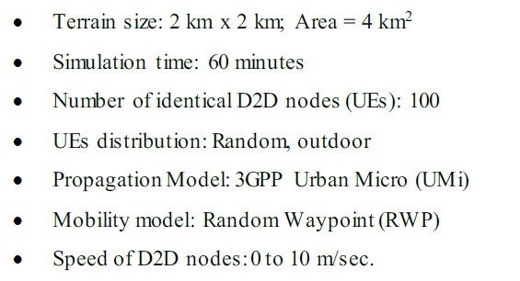
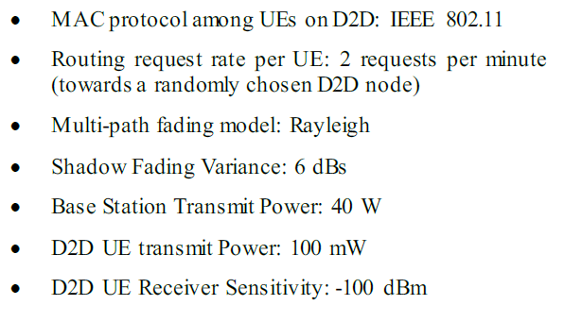
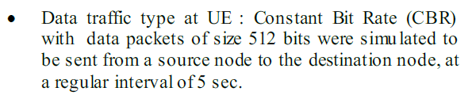
Simulation Results

Slide 13
Simulation Results
The following performance metrics were studied through simulation:
1. Average number of RREQ broadcast messages in the entire D2D network per routing request session.
2. Average number of RREQ messages sent to the base station per routing request session.
3. D2D Routing success probability.

Slide 14
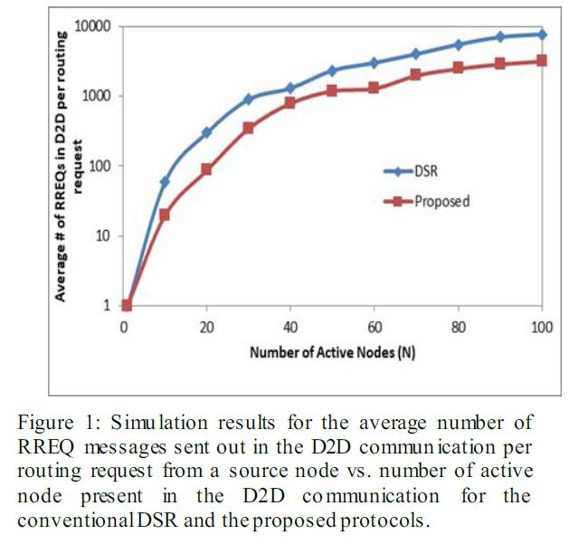
Comparison and Discussion
The simulation results for the average number of RREQ messages generated in the D2D communication in response to a single request from a source node.
Notes:
圖 1 顯示了隨著我們增加區域內活動 UE 的數量，D2D 通信中響應來自源節點的請求，而生成的平均 RREQ 訊息數量的模擬結果。
所提出的協議的性能比傳統的 DSR 至少提高 20%。較少的廣播流量也直接轉化為 UE 的節能。

Slide 15
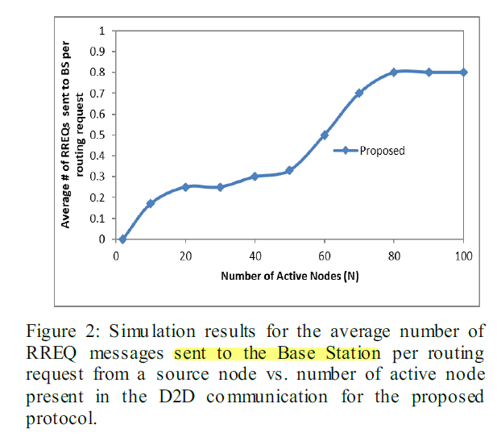
Comparison and Discussion
The simulation results for the average number of RREQ messages sent to the Base Station (BS) in response to a single request from a source node.
Notes:
圖 2 顯示了當我們增加單元中的節點數量時，為響應來自源節點的請求，而發送到基地台的 RREQ 封包的平均數量的模擬結果。
從圖中可以看出，RREQ數量隨著活動節點數量的增加而增加。
D2D 通信中的更多活動節點導致向遠距離節點發送路由請求，遠距離節點的路由信息​​在源節點的直接鄰居處不可用。

Slide 16
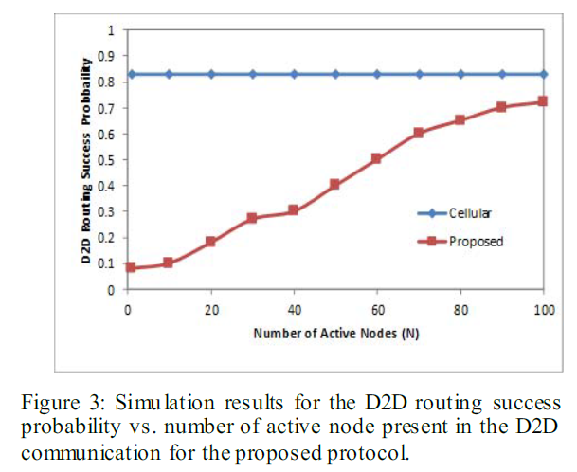
Comparison and Discussion
The simulation results for the probability that a D2D routing request results in eventual success.
More active nodes in a cell will result in higher success probability.
Only a few nodes in the cell, most probably, will be located at far distances from each other, resulting in coverage and poor SINR issues.
Notes:
圖 3 顯示了 D2D 路由請求最終成功的概率的模擬結果，作為活動節點數量的函數。同樣，小區域中的活動節點越多，D2D成功概率就越高。
小區中只有少數節點很可能彼此相距很遠，從而導致覆蓋範圍和 SINR (Signal-to-Interference+ Noise Ratio)問題較差；

Slide 17
Simulation Results
Design of a multi-hop routing protocol in D2D communication that provides both energy efficiency for the devices and fast route finding.
The protocol uses the base station to store the routing information. This storage can speed up the route discovery process in many cases.
Notes:
設計 D2D 通信中的多跳路由協議，為設備提供能源效率和快速路由查找。
該協議使用基站來存儲路由信息。在許多情況下，這種存儲可以加快路由發現過程。

Slide 19
SlidesCarnival icons are editable shapes.
This means that you can:
Resize them without losing quality.
Change line color, width and style.
Isn’t that nice? :)
Examples:

Slide 20
Diagrams and infographics

Slide 21
You can also use any emoji as an icon!
And of course it resizes without losing quality.
How? Follow Google instructions https://twitter.com/googledocs/status/730087240156643328
✋👆👉👍👤👦👧👨👩👪💃🏃💑❤😂😉😋😒😭👶😸🐟🍒🍔💣📌📖🔨🎃🎈🎨🏈🏰🌏🔌🔑 and many more...

